Slide 1

1. Install server with GUI
Windows Server 2019 Basics

Slide 2
Minimum Requirements
64 bit processor with 1.4 GHz
512 MB RAM (2GB if using the GUI version)
32GB HDD space

Slide 3
Minimum Requirements (revised)
64 bit processor with 1.4 GHz
512 MB RAM (2 GB if using the GUI version) – During installation you need at least 1 GB
32 GB HDD space
Notes:
While Windows Server 2019 could run on 512 MB, you need at least 1 GB of RAM for the installation phase.

Slide 4
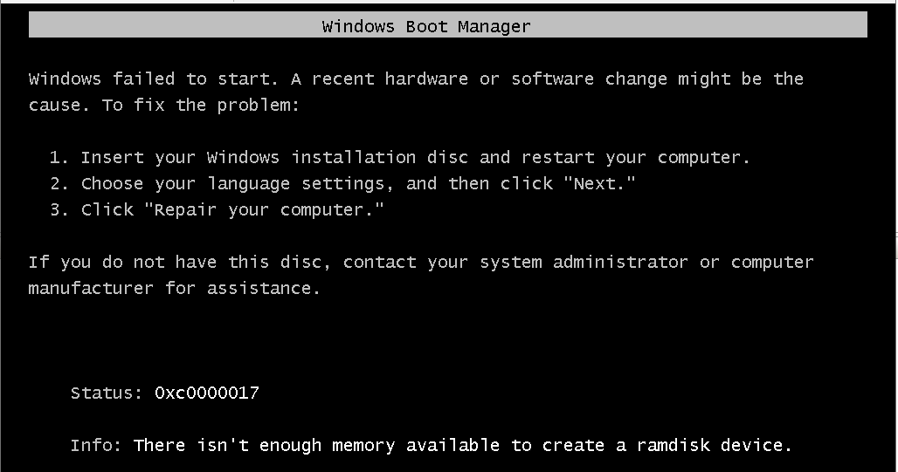
Minimum Requirements (not enough RAM)
Notes:
This happens when you try to install a VM that has 512 Minimum RAM and startup RAM.
To solve the issue just give the machine 1024 MB startup RAM; you can keep the 512 minimum RAM if you want.

Slide 5
Windows Server editions
Standard (one license for 2 VMs and the host)
Datacenter (one license for unlimited VMs and the host)

Slide 6
Standard vs Datacenter (roles and features)
Role/Feature | Standard | Datacenter
Hyper-V (Role) | Yes | Yes + Shielded VMs
Network controller (Role) | No | Yes
Host Guardian support for Hyper-V (Feature) | No | Yes
Constrained Storage replica (Feature) | Yes (1 partnership and 1 resource group with single 2 TB volume) | Yes (unlimited)
Software-defined networking (Feature) | No | Yes
Storage spaces direct (Feature) | No | Yes
Inherited activation | As guest if hosted on Datacenter | Can be guest or host

Slide 7
Installation options
Normal server (formerly Server Core)
Less resource intensive
Less HDD space needed
Less updates/hotfixes performed
Desktop experience (Windows 10 graphical shell over Windows Server)

Slide 8
Installation types
Clean install (formats the HDD; all data is lost)
Upgrade from a previous version (only from 2012 R2 or 2016 is supported; data and settings are preserved)

Slide 9
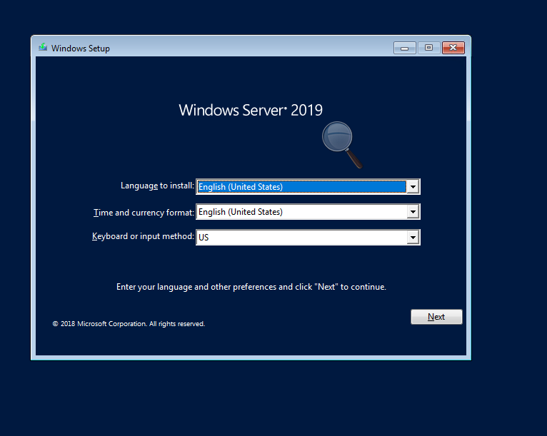
Notes:
You can select the OS language to be used. If the ISO is the English version only this language is selectable
Time and currency format and keyboard layout can be selected based on your region. I recommend sticking to English US for both

Slide 10
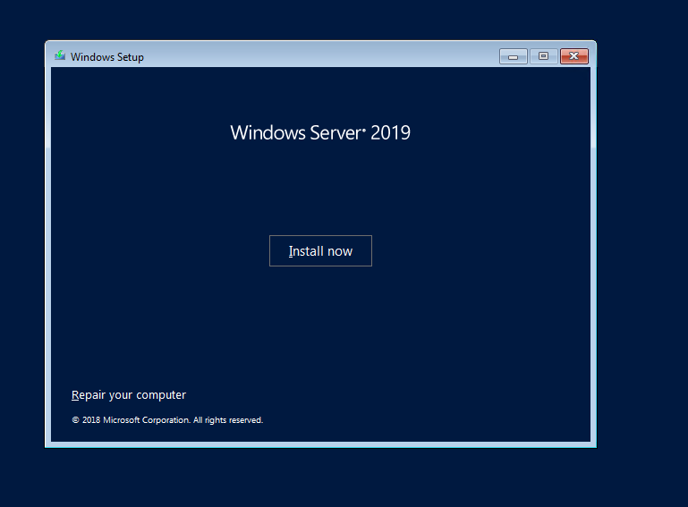
Notes:
Besides installing Windows, you also have some repair and recovery tools on the installation media

Slide 11
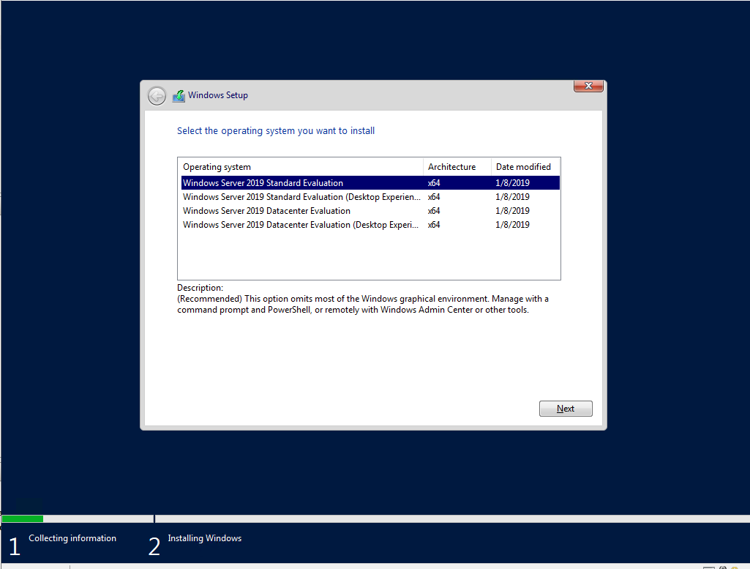
Notes:
The 2 most used Windows Server editions are Standard and Datacenter but there are also others like Hyper-V Server, Windows Essentials, Windows Storage Server.
Besides the 2 editions available on the disc, you can also choose if your server will have a graphical user interface or not.

Slide 12
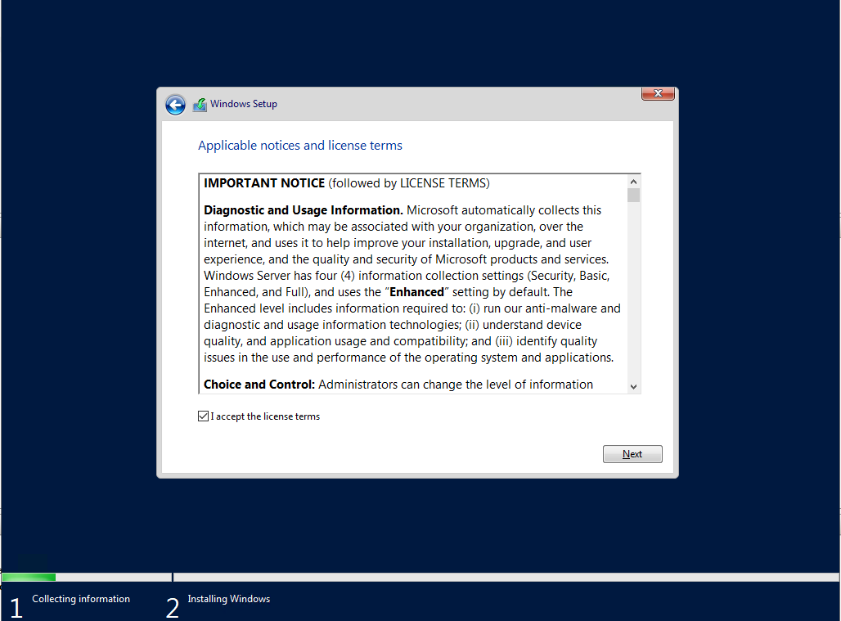

Slide 13
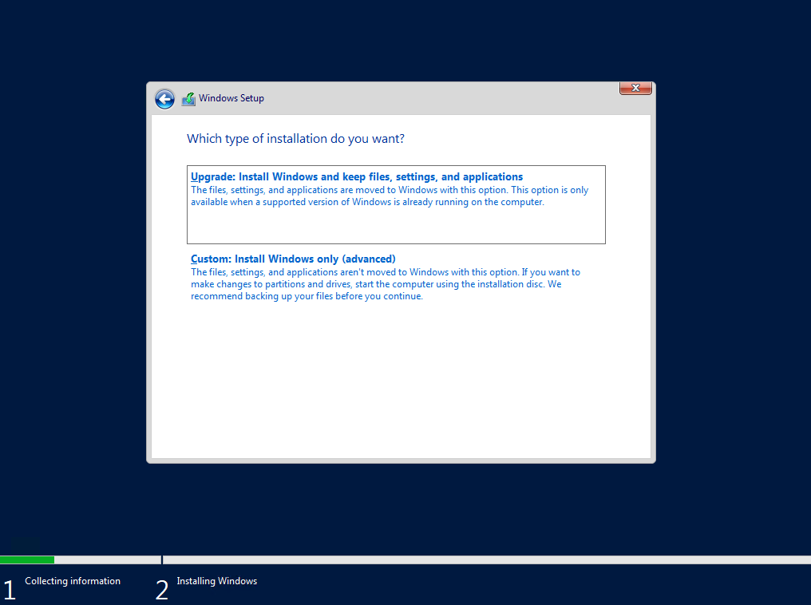
Notes:
You have the option to perform a clean install: the selected HDD will be formatted, all data will be lost and you will get a fresh and clean install of Windows Server
The other installation option is the upgrade from a previous version of Windows Server. The supported paths for upgrade are from 2012 R2 to 2019 and from 2016 to 2019

Slide 14
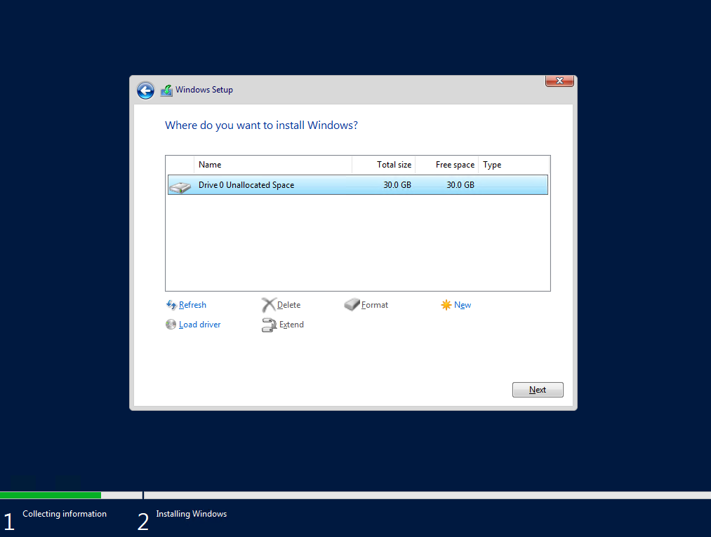
Notes:
Here you get to select the disk that the OS will be placed on. You can also create partitions if you want to.
If installing on hardware and you do not see any disks there may be 2 possibilities for this:
- You need a storage drive in order to recognize the controller (use Load driver and after that Refresh)
- No volumes have been created on your RAID controller

Slide 15
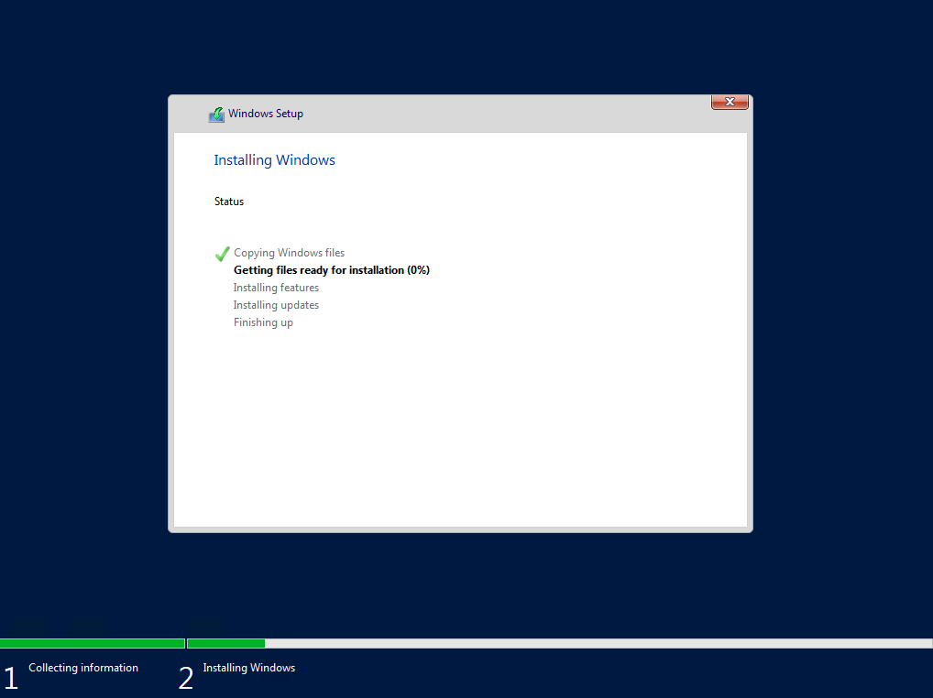
Notes:
Just sit back and let Windows Server install. After some restarts you will be prompted to change the local Administrator’s password

Slide 16
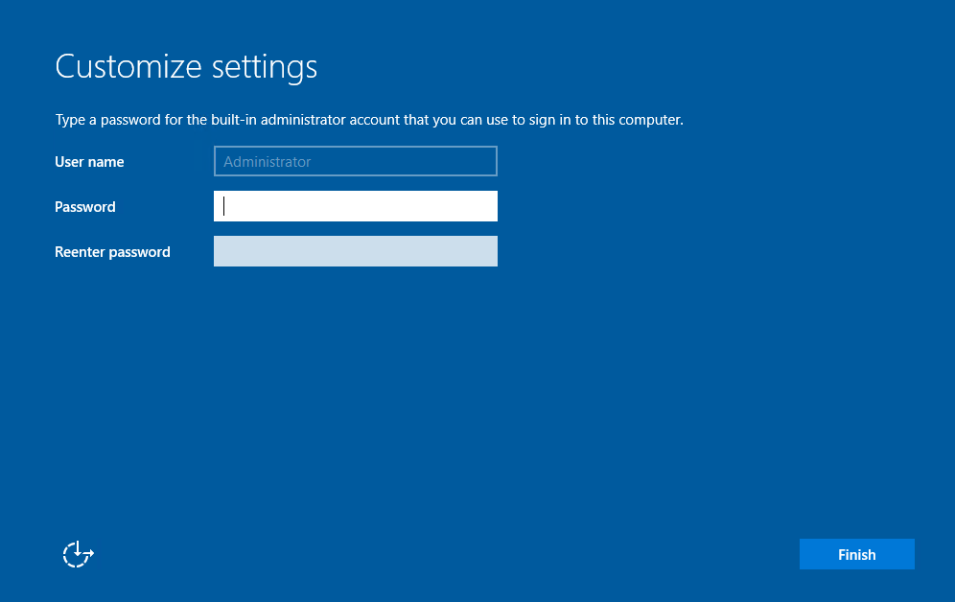
Notes:
You have to set a password for the local Administrator user. Because of the Local Security Policy you have to use 3 of the 4 character types:
- Uppercase letters
- Lowercase letters
- Numbers
- Special characters

Slide 17
https://www.youtube.com/channel/UCcZ-jLbPwNr8E_v9-65n8Iw https://github.com/itknowledge4

